Slide 1
5 Hacks for Studying like a PRO!
ETHOS TIME
⏰

Slide 2
CLICK HERE TO WATCH THIS USEFUL VIDEO
ETHOS TIME
⏰

Slide 3
YOUR PRO TASK:
Go through the FIVE HACKS and make a plan for which ONE OR TWO you will try this week. What exactly can you do? What is the priority for you right now?
Review at the end of the week and try another HACK next week
Keep a record of what makes the most difference for you!
REPEAT AND BECOME A PRO!
ETHOS TIME
⏰

Slide 4
What can you try this week?
Plan your time
Set alarms to remind you about your plan to study, it can be easy to get distracted by another activity.
Think about the time of day that you work best in. Are you a morning person or do you prefer to start later in the day?
Put things up on your wall to remind you of important dates and deadlines. This can also be useful for key phrases/dates/words that you need to remember. Post it notes are your friend!
Learn to love a to-do list! This will help to break things down into manageable chunks and will stop you feeling overwhelmed.
Set yourself time limits so that you don’t spend too long on one task leaving little time for another.
1
ETHOS TIME
⏰

Slide 5
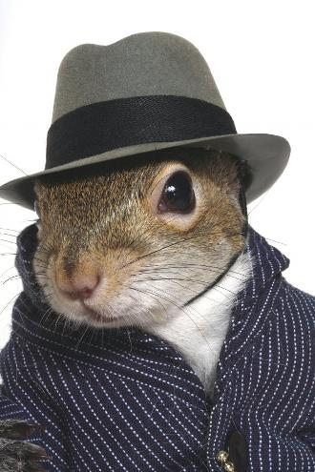
What can you try this week?
Remove distractions
Change where you study every so often, particularly if you are finding it hard to focus.
TV, it’s too easy to watch just one more episode and before you know it the day has gone. Instead use it as a reward for your efforts.
Leave your phone in another room, constant notifications can be very distracting and tempting to reply to.
People can be a big distraction, share you study plans with the people that are important to you. They will then be able to support you rather than distract you.
2
ETHOS TIME
⏰

Slide 6
What can you try this week?
Learn, Rest, Repeat
Start your study session by reviewing what you did previously. Repetition helps to secure memories, helping you to feel confident about moving on to the next task.
3
ETHOS TIME
⏰

Slide 7
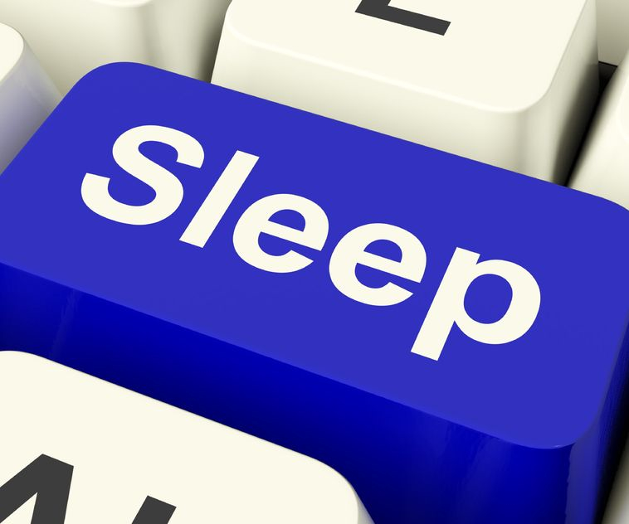
What can you try this week?
4
Move around
Physical exercise can help you to focus and stay on task. It can also improve your Mental Health, even if it’s just a walk around the block regularly.
Sleep
Sleep gives you energy and boosts your immune system helping your body recover from Illnesses.
Rest your mind, sleep helps your brain to recover and revive itself, storing your memories and creating new ideas. Important when studying.
Sleep allows your mind to unwind and de-stress. This allows your mental and emotional wellbeing to be restored.
5
ETHOS TIME
⏰

Slide 8
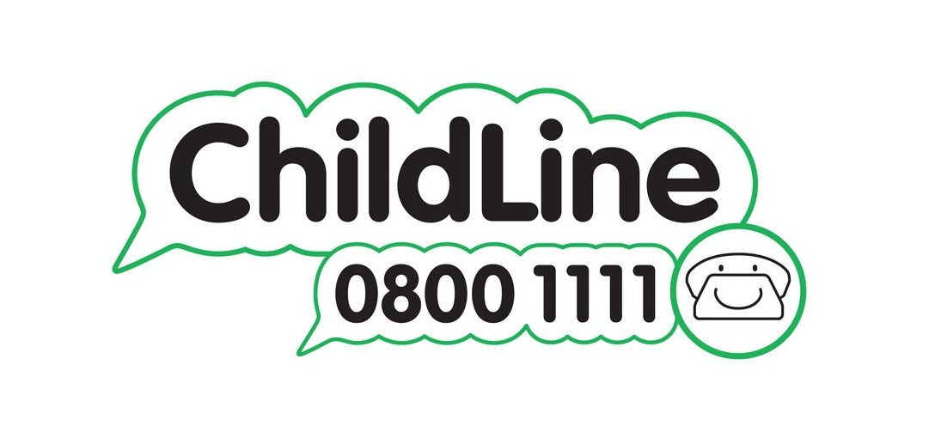
Further Reading & Resources:
Lessons to study skills, find lots of useful stuff on BBC Bitesize. https://www.bbc.co.uk/bitesize
Top advice on how to get that all important sleep you need
https://www.nhs.uk/oneyou/for-your-body/sleep-better/
Feeling stressed out by exams and need some advice?
https://youngminds.org.uk/find-help/feelings-and-symptoms/exam-stress/
Need to talk?
ETHOS TIME
⏰

