Slide 1
FIVE WAYS TO MAKE THE MOST OUT OF YOUR TIME…
TAKE THE #ETHOSCHALLENGE ON SOCIAL MEDIA
ETHOS TIME
⏰

Slide 2
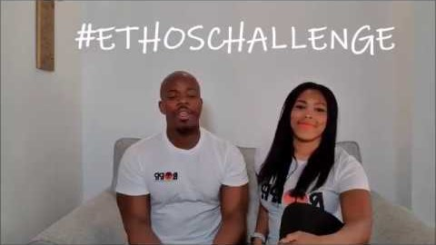
CHECK OUT TODAY’S VIDEO…
TAKE THE #ETHOSCHALLENGE ON SOCIAL MEDIA
ETHOS TIME
⏰

Slide 3
Purpose?
When plans are interrupted it can feel like you are wandering and have no purpose. By putting a new PLAN in place we get vision and direction.
TAKE THE #ETHOSCHALLENGE ON SOCIAL MEDIA
ETHOS TIME
⏰

Slide 4
1
Who do you want to be?
In a morning choose your character, who you want to be. Are you showing others kindness, generosity, patience, courage, humour, thoughtfulness? When you speak or interact with someone make sure remember to frame your attitude with who you want to be.
2
Who do you want to connect with?
Everyday choose one person to facetime/call/post a letter to/send a text or email to. Think about the people who are important to you and make sure you invest time in them. Think about people who may be isolated or lonely and connect with them. Think about someone who inspires you or makes you laugh and listen to them.
3
Who can you make a difference to?
Supporting others (makes sure you do all this without breaking social distancing rules) gives us a genuine feeling of being useful, and gives you purpose. Giving to others releases endorphins, the happy hormones!! So, make a choice today to take care of someone else. Make your mum a cup of tea or even offer to cook dinner, you could even call a family member or friend who lives alone.
ETHOS TIME
⏰

Slide 5
4
Where do you want to invest your resources?
What do you have that you can make the most of? It can be scary to focus on; but looking at the choices we make with the time, money and resources we have, controlling what we can, and getting the right support from the right people if we need it, can make a real difference.
5
What plans do you have for when lockdown is fully lifted?
Don’t forget that this WILL end! Now is the time to make a list of the things you miss doing and are important to you. Choosing to plan adventure into your future gives you a sense of purpose for ‘then’. Use this list to make a plan. Maybe plan a family meal, or a hike over the Peak District, or a visit to a city. Get creative because the adventures are yours to take.
TAKE THE #ETHOSCHALLENGE ON SOCIAL MEDIA
ETHOS TIME
⏰

Slide 6
TAKE THE #ETHOSCHALLENGE
ON SOCIAL MEDIA
Write a list of what GREAT THINGS you are planning to do in the future and share it on social media to inspire others.
Use the hashtag #ethoschallenge to share with others.
Follow us on Instagram: @GracefoundationUK
TAKE THE #ETHOSCHALLENGE ON SOCIAL MEDIA
ETHOS TIME
⏰

